Slide 1
Reframing tricky work relationships
Liz Wiggins and Harriet Hunter
27th March 2017

Slide 2
In summary
Psychological pay offs in tricky relationships keep them stuck
Someone needs to make the first gesture to shift the dynamic
Seeing your own role and that of others differently allows you to make that first gesture
And you might need to make several gestures…
The drama triangle to the winner’s triangle makes everyone a winner

Slide 3
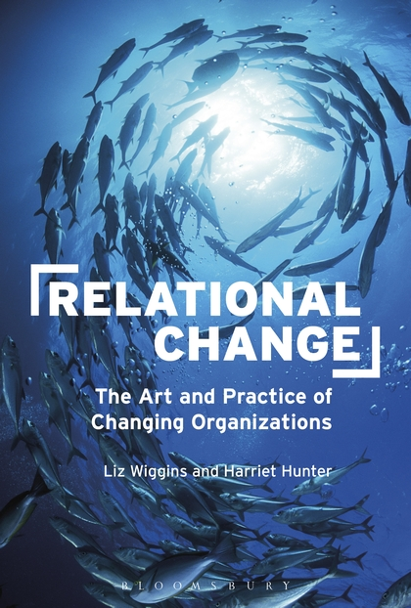
Seeing organizations differently
Seeing change differently
Dynamics of change –push and pull
Working well with politics
Recognizing and shifting power dynamics
Recognising and working well with emotions
Re-imaging meetings
Working well in the moment
Working with stuckness
Sustaining self and others in change
Notes:
Book in middle
Type of things covered in the book either side
Seeing organizations differently
Seeing change differently
Dynamics of change –push and pull
Working well with politics
Recognizing and shifting power dynmaics
Recognising and working well with emotions
Re-imaging meetings
Working well in the moment
Working with stuckness
Sustaining self and others in change

